Slide 1
credit Analysis
Presented By : Purwo Aji

Slide 2
What we want to know
What are the variables / parameters that affect the credit default the most?
Is there any other variables / parameters that might be affected?

Slide 3
What we have
Data contain 22 variable with 1000 rows
Variable : account_check_status, duration_in_month, credit_history, purpose, credit_amount, savings, present_emp_since, installment_as_income_perc, sex, personal_status, other_debtors, present_res_since, property, age, other_installment_plans, housing, credits_this_bank, job, people_under_maintenance, telephone, foreign_worker

Slide 4
What we think
Initial hypothesis : duration in month and credit amount is most affecting variable for credit default

Slide 5
What we do
Doing statistical analytics (correlation and regression)
Exploratory analysis

Slide 6
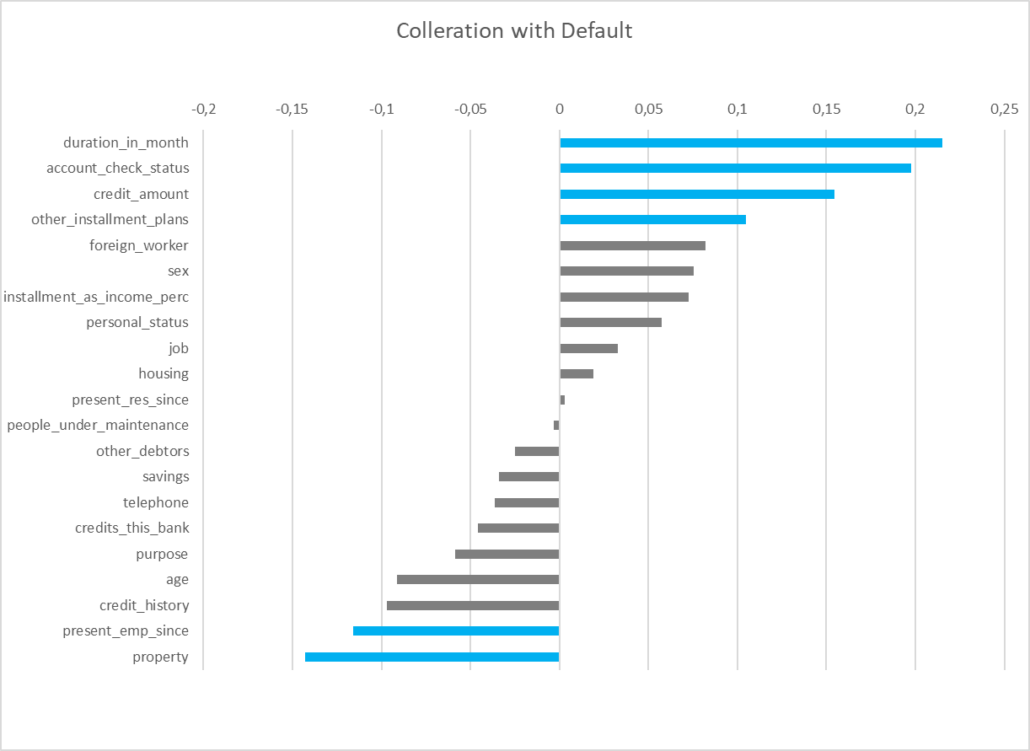
Correlation
The results do not show that there is a variable that has a strong correlation with credit default
Therefore, I chose a variable with a correlation value ± 0.10 for further analysis

Slide 7
Regression
The regression result show credit amount not affected the credit default

Slide 8
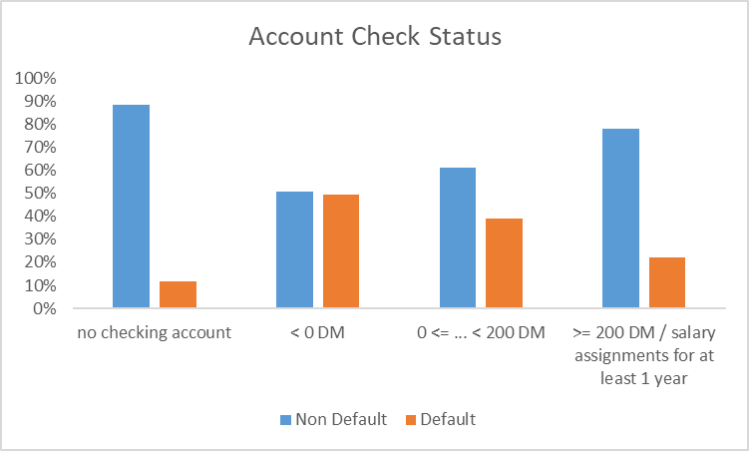
Account check status
The greater the amount of savings, the possibility of a default is even smaller

Slide 9
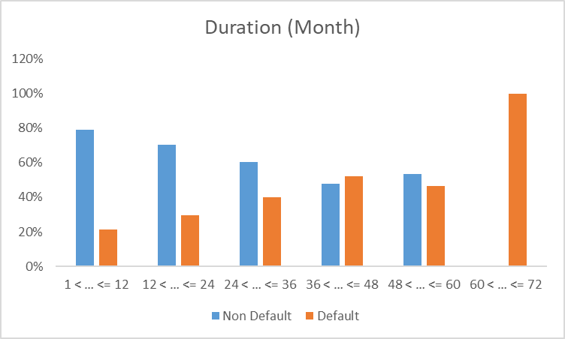
Duration
The possibility of a default is directly proportional to the period of the credit

Slide 10
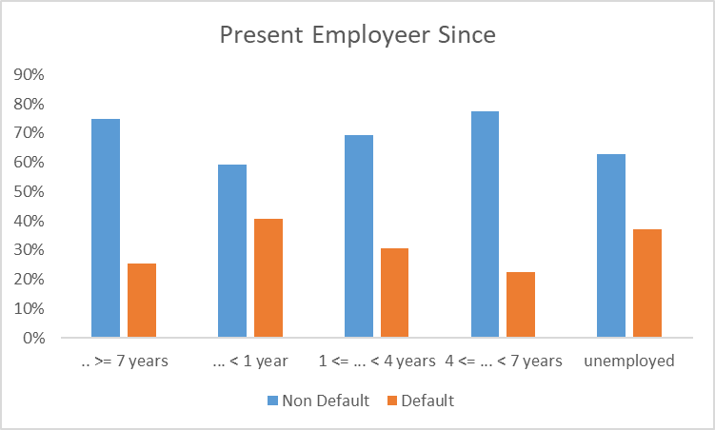
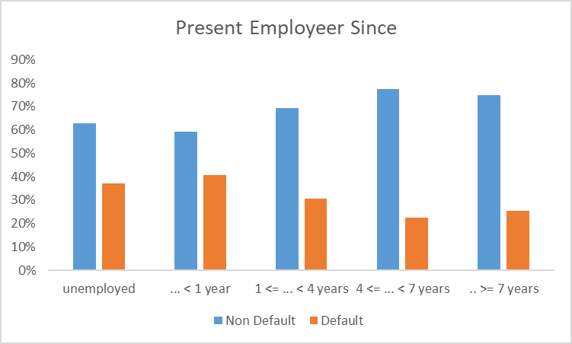
Employeer Since
The longer the work experience, the probability of default is even smaller

Slide 11
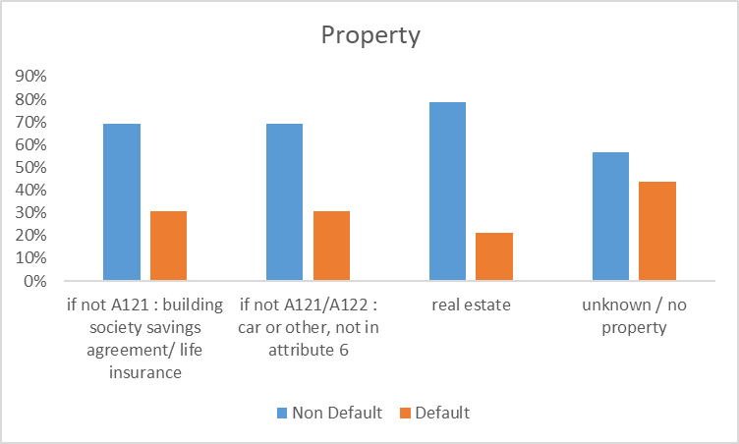
Property
People who do not own property have a probability that they will be default

Slide 12
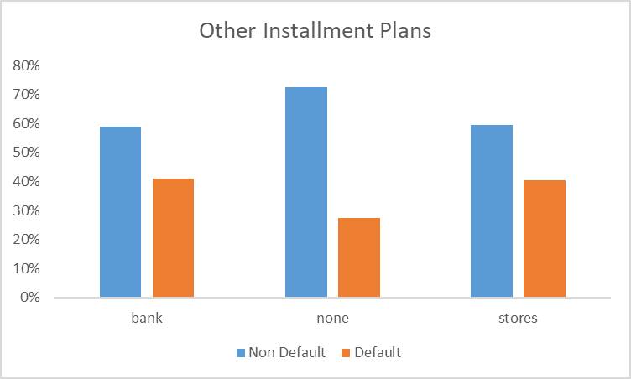
Other installments
People who make installments through banks and stores have a great chance of getting their credit

Slide 13
Summarize
There are no variables / parameters that affect the default the most
The possible influencing variables are:
Account Check
Duration
Length of Work
Property
Installment Plans
The variables are sufficient, maybe to get better results you can add the amount of data

Slide 14
What we will do
Further analysis using WoE - IV or maybe advanced statistics
Gather more data

Slide 15
THANK YOU!!!

